Slide 1

LEARN + NOVA = NEW STAR OF LEARNING
LEARNOVA
AI-Powered Personalized Learning System

Slide 2
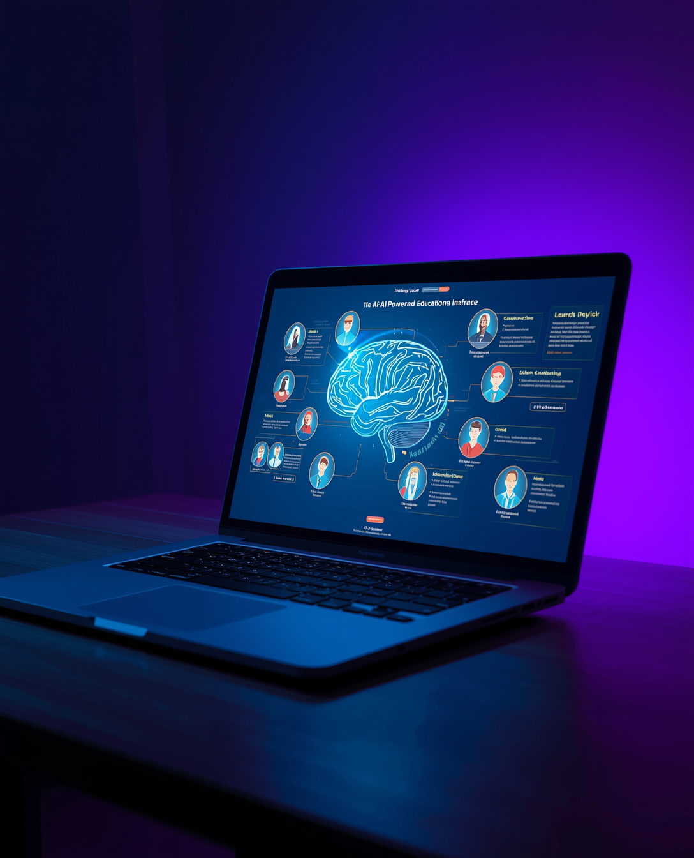
LEARNOVA
ABSTRACT
Learnova is an AI-powered personalized learning application designed to enhance the educational experience of school students through intelligent and adaptive technology. The system provides grade-wise structured academic content combined with interactive AI-generated explanations to improve concept clarity.
It integrates an AI assistant and avatar-based teaching interface that delivers explanations in both English and Hinglish, making learning more accessible and engaging. The platform also includes automated assessment features such as topic-wise quizzes, full-length test series, and descriptive answer evaluation using semantic similarity techniques from Natural Language Processing (NLP).
The primary objective of Learnova is to enable personalized learning, improve student engagement, and provide scalable, efficient, and automated evaluation, thereby transforming traditional education into a smarter and more interactive experience.

Slide 3
LITERATUTE REVIEW
Feature
Existing AI Tutoring Systems
Proposed System – Learnova
Learning Content Delivery
Language Support
Teaching Method
Personalization Level
Assessment Type
Descriptive Answer Evaluation
Test Integrity Features
Static videos, notes, recommendation-based content
English-only support
Chatbots / text-based explanations
Limited personalization
Mostly MCQs, manual evaluation
Not supported or manual checking
Rarely implemented
AI-based interactive explanations (grade-wise)
Hinglish + English bilingual explanation with language switching
Interactive avatar-based teaching assistant explaining topics dynamically
Grade-adaptive learning, topic-level quizzes, and adaptive suggestions
Quizzes + full test series
AI-based semantic answer evaluation
Exam monitoring (timer, tab-switch detection)

Slide 4

INTRODUCTION
The Problem
OUR SOLUTION
Traditional learning relies on static content with no personalization. Every student gets the same material regardless of their needs.
THE CHALLENGE
LEARNOVA uses AI to adapt content in real-time, providing personalized learning paths for each student's unique pace and style.
One-size-fits-all approach fails diverse learners. Students fall behind or lose interest without adaptive pacing.

